Slide 1
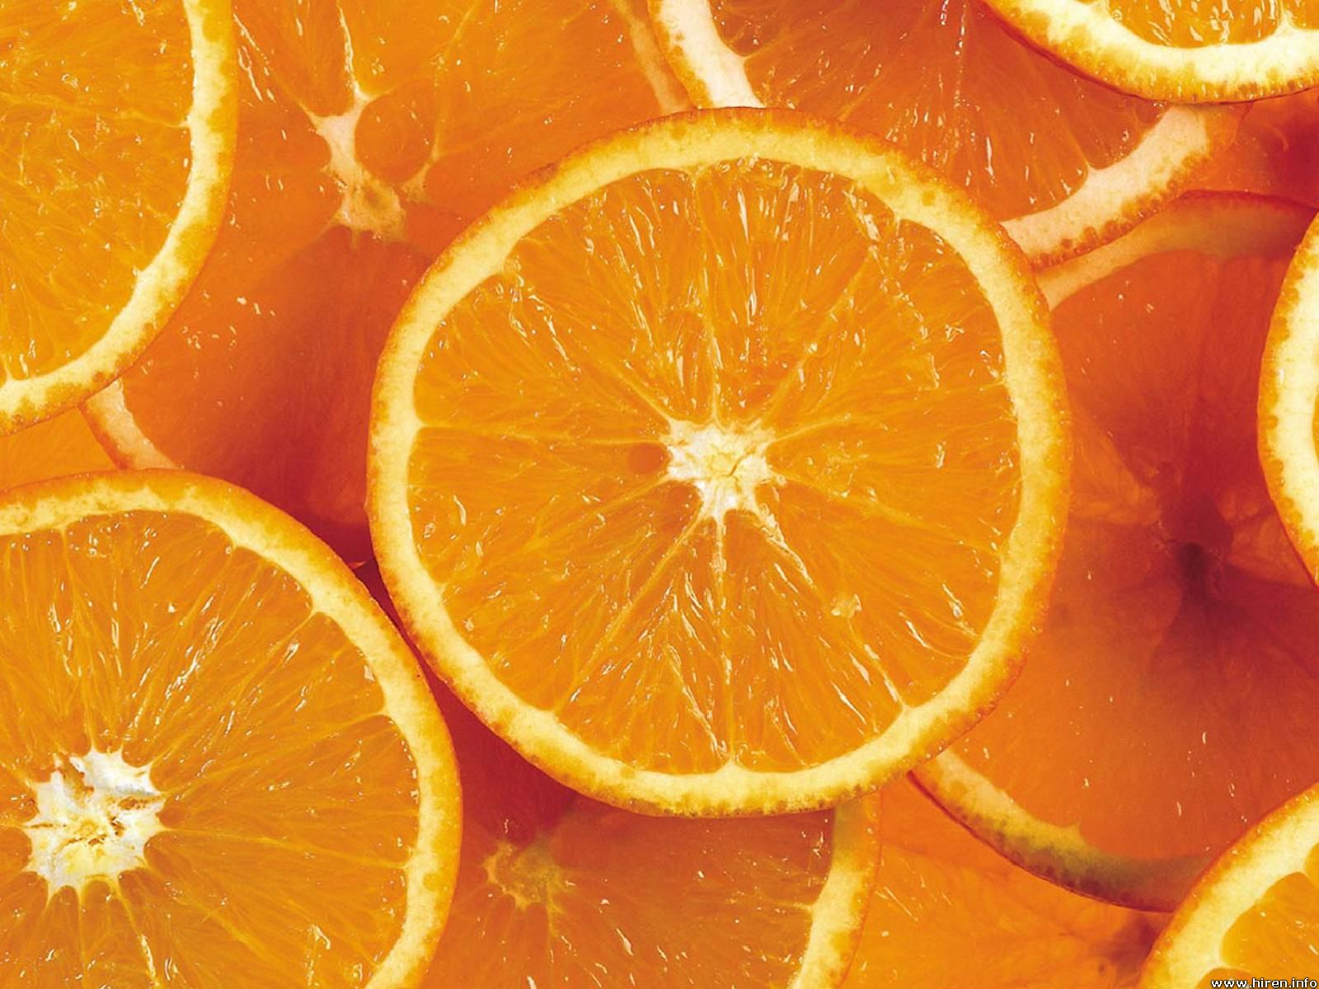
Remember you number
Find your common numbers, this is now you group (you have 30 seconds)
Give each member in the group a number from 1 to 3
Notes:
Form groups of 2 or 3 ( number students from 1 through to 11) (10 groups of 3 and one 2) Each number will be a group.
Assign each person in the group a number
Assign tasks to each student

Slide 2
Investigation
Calculate the Surface Area of a sphere using oranges.

Slide 3


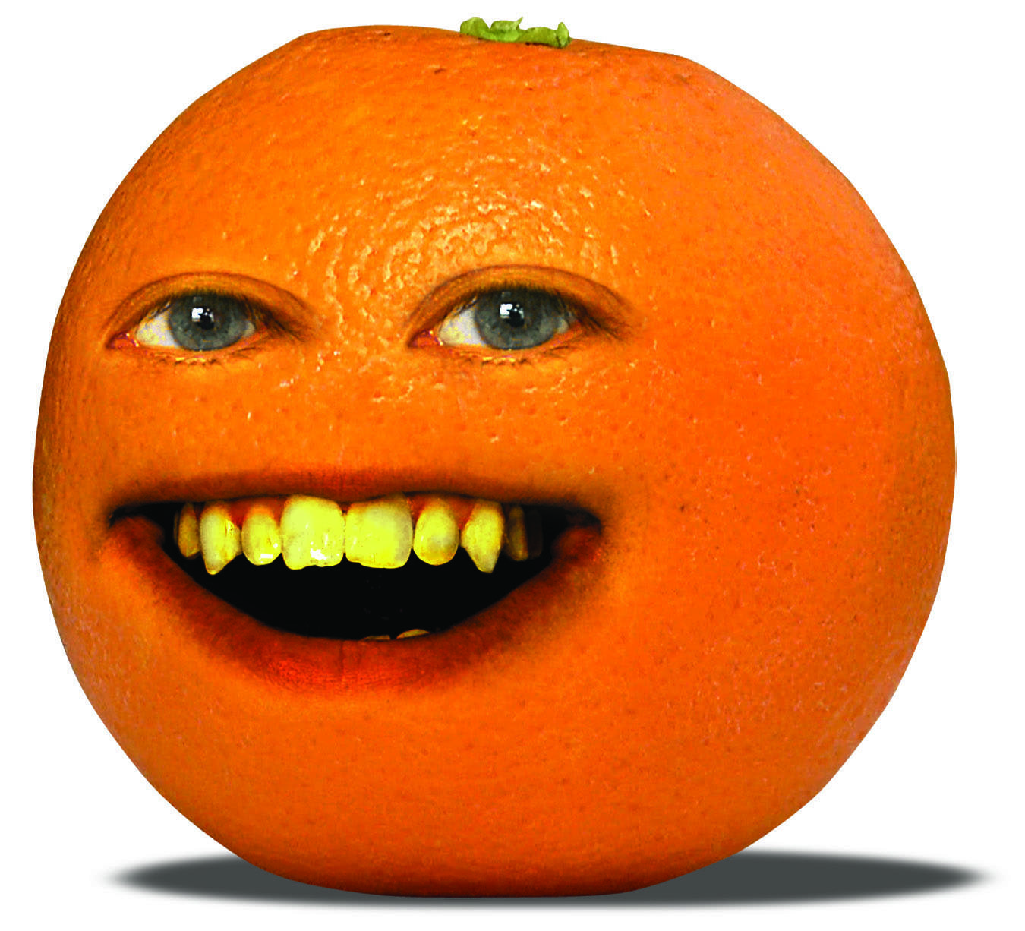
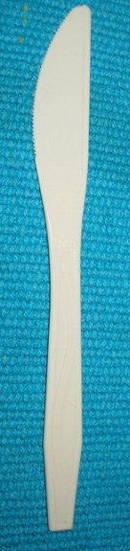
You will need
A group of eager minds
String
An orange (1 per group)
Paper towel (A3 paper is fine)
Knife (plastic only)
Compass
Ruler
Notes:
Assign one member from each group to collect the materials (number 3)

Slide 4
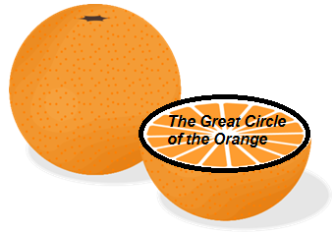
THE GREAT CIRCLE OF THE ORANGE
Mould your orange, so it is as close to a sphere as possible.
Using string, find the circumference of the orange and hence calculate the radius.
Notes:
Assign roles for each task. Number 1 measures, number 2 scribes, and number 3 holds the string

Slide 5
THE GREAT CIRCLE OF THE ORANGE
Use your radius and compass to draw the great circle of the orange.
If we peel an orange how many great circles do you think your peel will fill up?
(draw that many circles)
Notes:
TPS with the how many circles- get an answer from each group (number 2 to draw the circle)

Slide 6
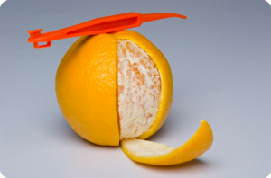
Lets get peelin’
- Carefully peel the orange
Fill as many Great Circles with the peel as possible. Make sure the pieces of peel don’t overlap. (do one circle at a time)
Record the number of Great Circles you have filled.
Notes:
Assign roles again, a peeler, and two puzzlers

Slide 7

Questions
Write a mathematical expression for the area covered in each great circle.
How many circles did you cover?
Based on your results, create a rule or equation that gives the surface area of the orange
Do you think this will work for all spheres?
BE PREPARED TO SHARE YOUR FINDINGS
Notes:
Get one from each group to share their results ( again assign roles to group members)

Slide 8


The actual formula for surface area of a sphere is…
$$4πr^{2}$$
Is this what you found?

Slide 9

Clean up!
Make sure all the rubbish (peels and paper) go in the bins
You may eat the oranges

Slide 10
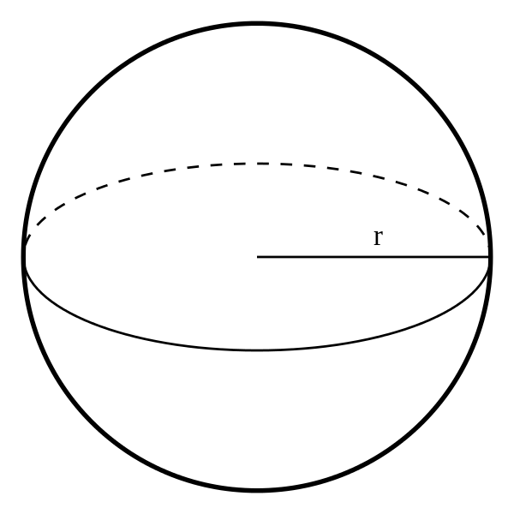
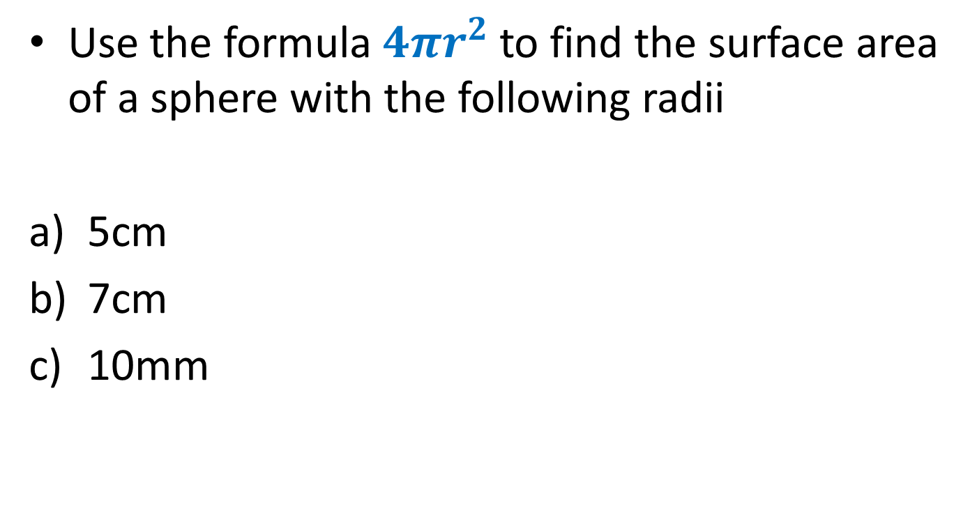
Find the Surface Area
Use the formula $4πr^{2}$ to find the surface area of a sphere with the following radii
5cm
7cm
10mm

Slide 11
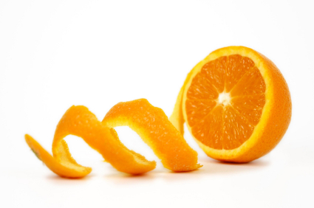
I hope you found this lesson…
A Peeling

